Slide 1
INFORMATION OF JAVA ,FEATURE OF JAVA, ARCHITECTURE OF JAVA
PRESENTED BY-
NIKITA MAHANGADE
DATE:-29/10/2024

Slide 2
WHAT IS JAVA
Java is a high-level, object-oriented programming language developed by James Gosling in the 1995s.
It is designed to be platform-independent, which means that code written in Java can run on any device that has a Java Virtual Machine (JVM).
This "write once, run anywhere" capability is one of its key features.

Slide 3
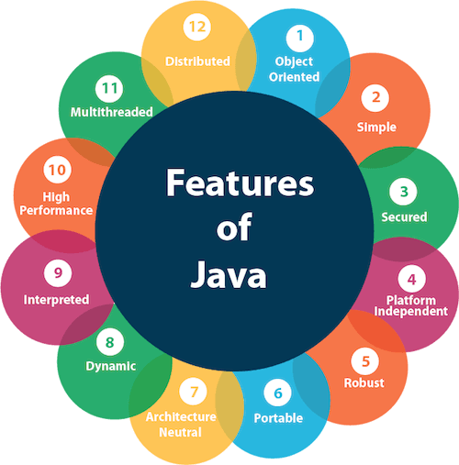
FEATURES OF JAVA

Slide 4
FEATURES OF JAVA
Platform independence:- Java code can run on any device with a Java Virtual Machine.
Object-oriented:- Java follows OOP principles like encapsulation, inheritance, polymorphism.
Simple and familiar syntax:- Java's syntax is based on C++.
Robust security:- Java has built-in security features like memory management, data encryption.
Large community:- Java has a vast ecosystem of developers, libraries, and tools.
Overall, Java remains a crucial language in software development due to its versatility and robustness.

Slide 5
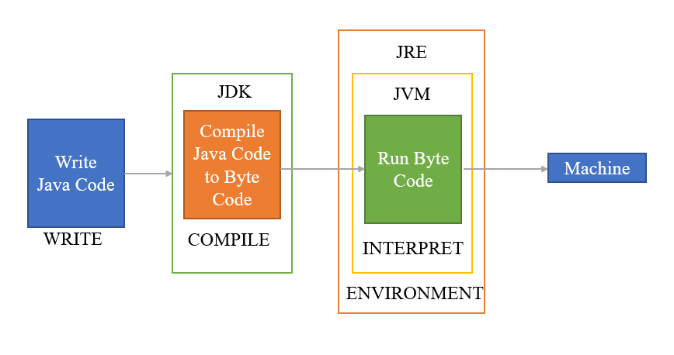
Architecture of Java

Slide 6
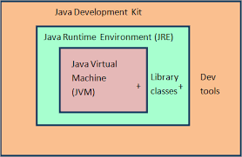
Components of Java Architecture
The different components of Java architecture are
JRE — Java Runtime Environment
JDK — Java Development Kit
JVM — Java Virtual Machine

Slide 7
Java Runtime Environment(JRE)
Java Runtime Environment provides an platform where all the applications like JVM and other runtime libraries linked together to run your Java Program.
It builds a runtime environment where you can execute the Java program. The JRE also initiates the JVM for its execution.
JRE has the required software and libraries to run the programs.

Slide 8
Java Development Kit (JDK)
Java Development Kit is the set of libraries, compiler, interpreter and other set of programs that will help you to build the Java program.
Once JDK installed on machine then start developing, compile and run the Java program. You cannot compile Java program without JDK installed on machine. Once you compile the code with JDK tools, you can get an Byte Code File.
java : it is the launcher for all the java applications.
javac : compiler of the java programming languages.
javadoc: it is the API documentation generator.
jar: creates and manage all the JAR files.

Slide 9
Java Virtual Machine(JVM)
JVM is the interpreter that executes the byte codes into Machine code.
The best quality is WORA( Write Once Run Anywhere). This means code can runs its applications on any platform. This makes Java as Platform Independent.
JVM performs the following functions:
Loads the code
Verifies the code
Executes the code
Provides runtime environment

Slide 10
APPLICATIONS
1. Android apps
2. Web applications
3. Enterprise software
4. Desktop applications
5. Games

Slide 11
THANK YOU..

